Slide 1
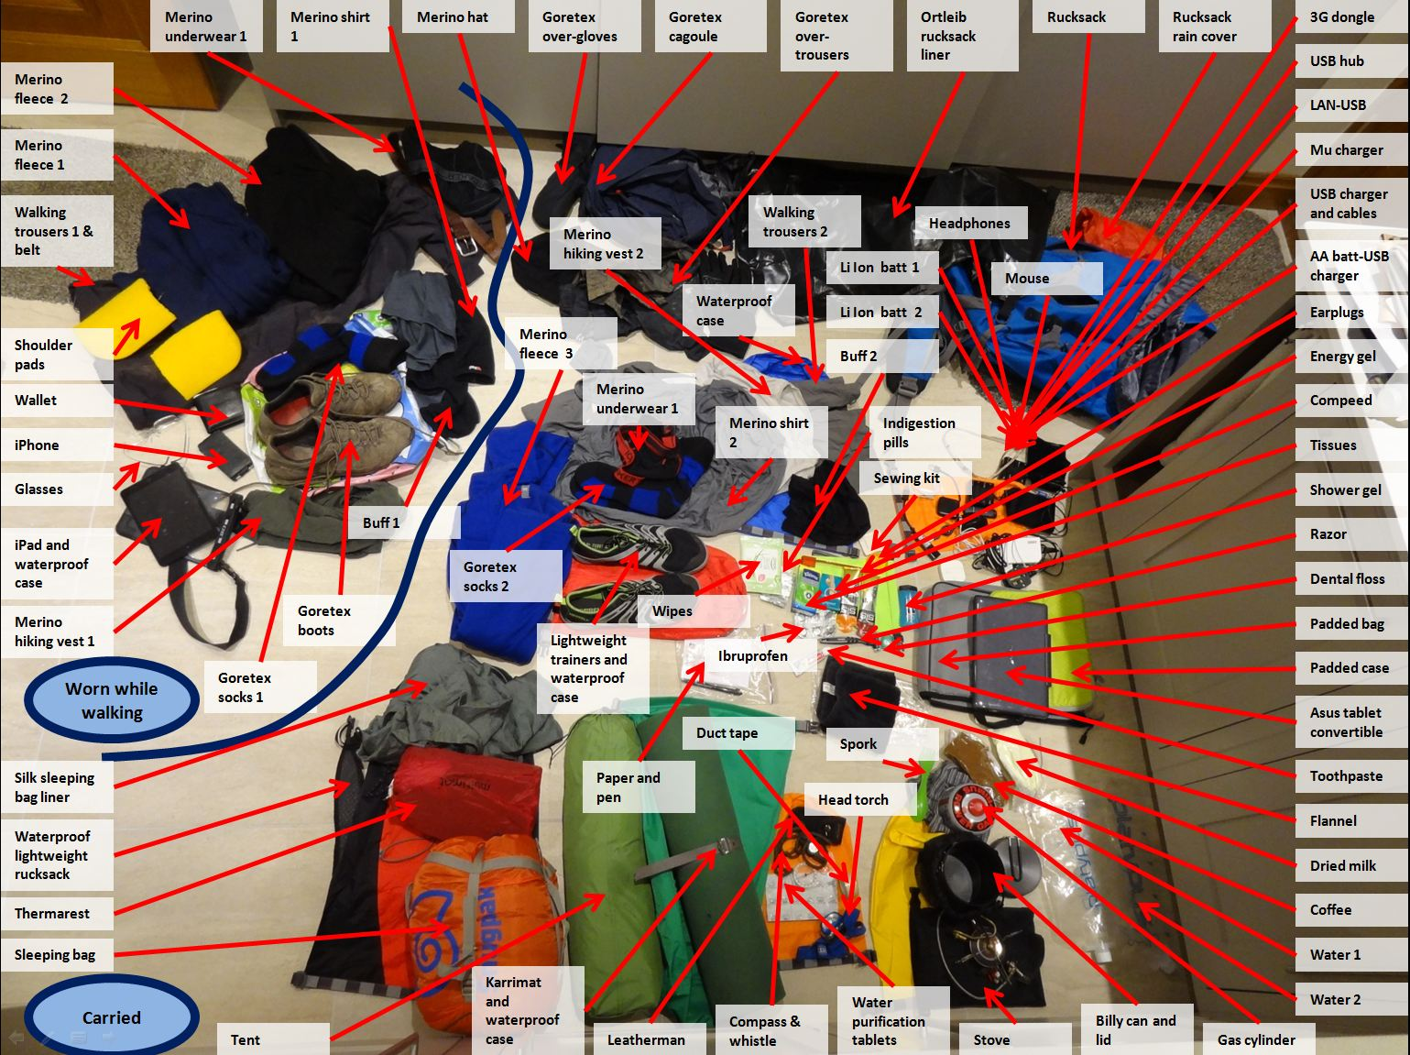
Test powerpoint file
For upload to LDWA website

