Slide 1
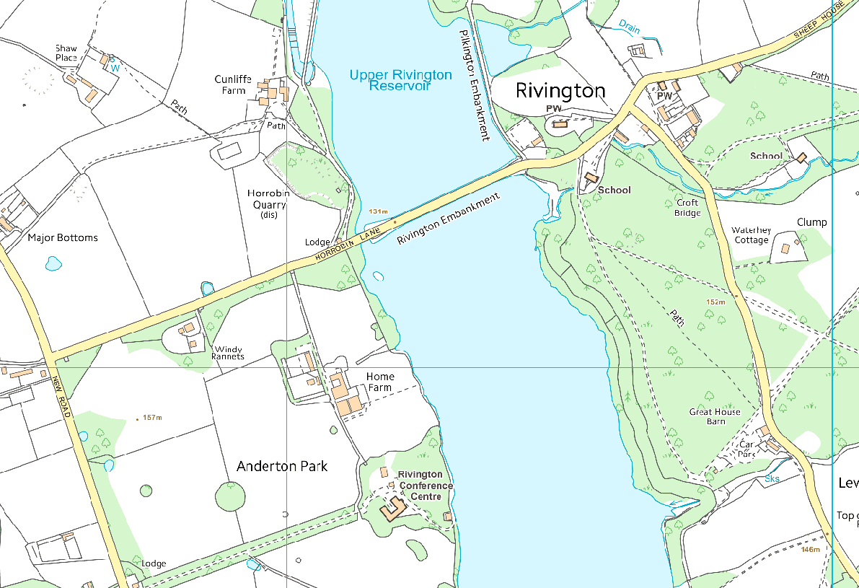
Supporters car-parking
(Note1) Limited parking is available on Rivington Embankment, Horrobin Lane.
(Note 2) A small car-park is located adjacent to Rivington Foundation Primary School.
(Note 3) Parking is available on an unmade road located off Rivington Lane (first left
After driving through village when coming from Horrobin Lane).
(Note 4) Great House barn Car-park and café (toilets available).
(note 5) Access Road to Rivington Hall barn.
Note 3
Note 1
Note2
Note 5
Note 4
Walk HQ
NO SUPPORTERS PARKING ALLOWED

