Slide 1
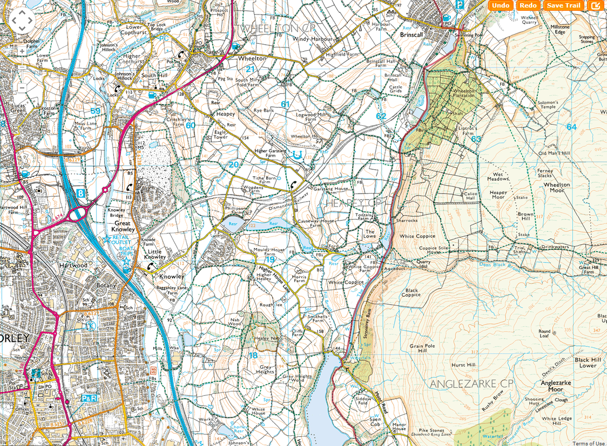
SHEET 21
CP14

Slide 2
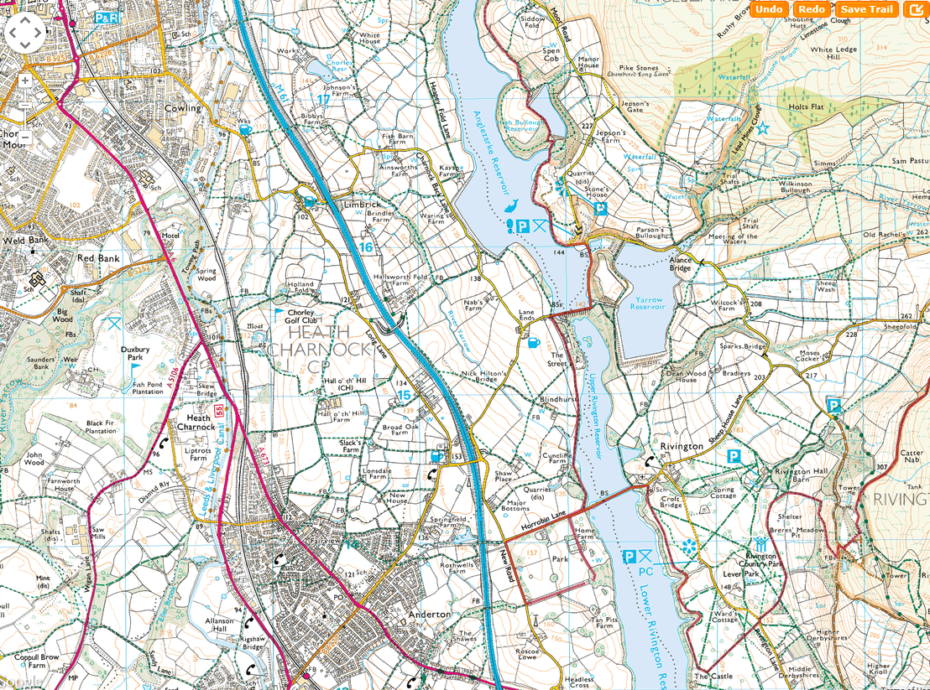
SHEET 22
FINISH

