Slide 1
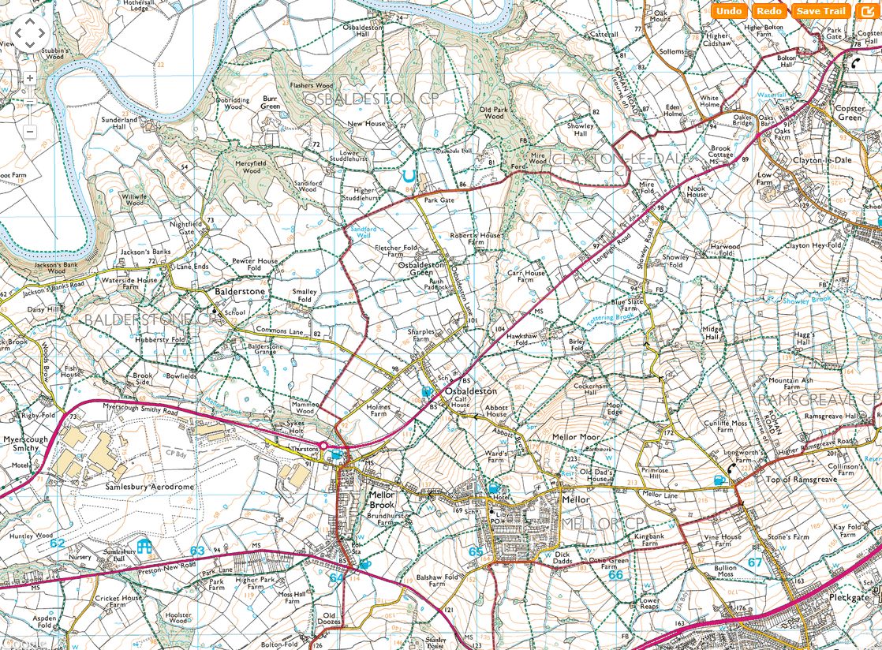
SHEET 18
CP12

Slide 2
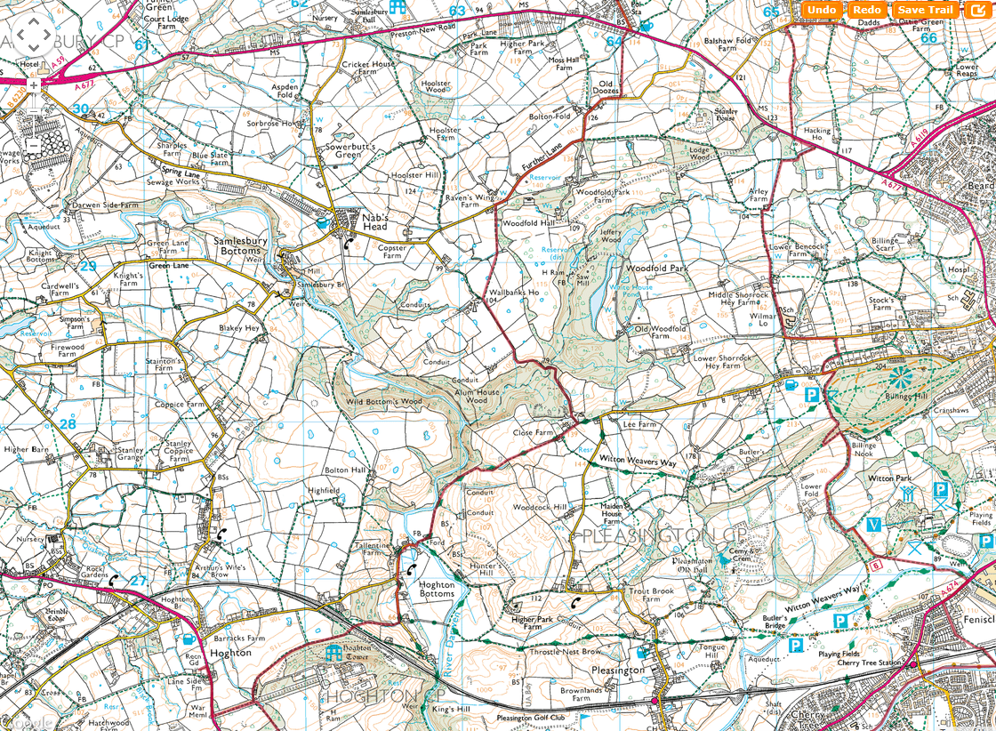
SHEET 19
CP13

Slide 3
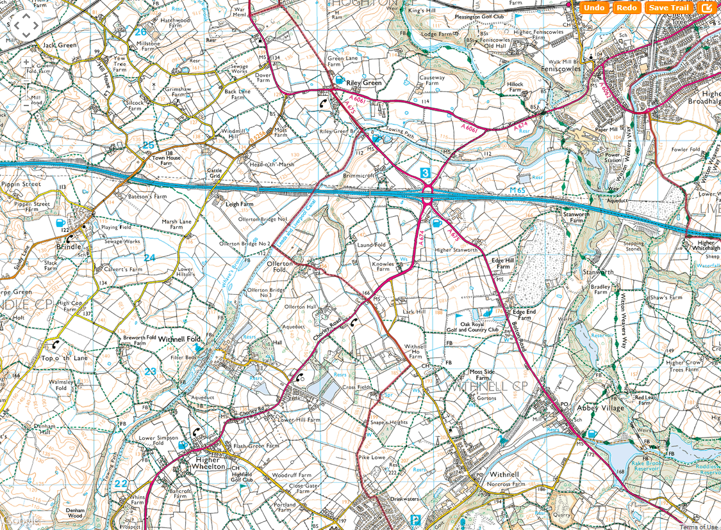
SHEET 20

