Slide 1
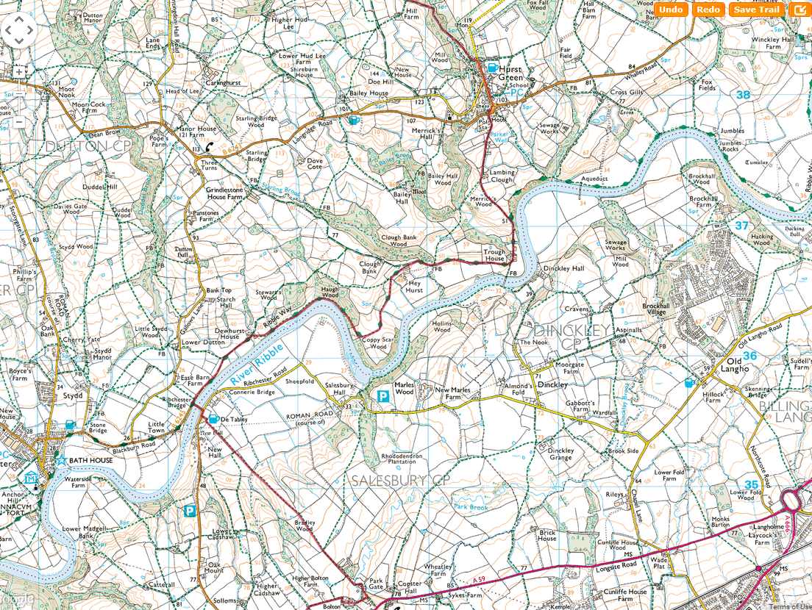
SHEET 17
CP11

