Slide 1
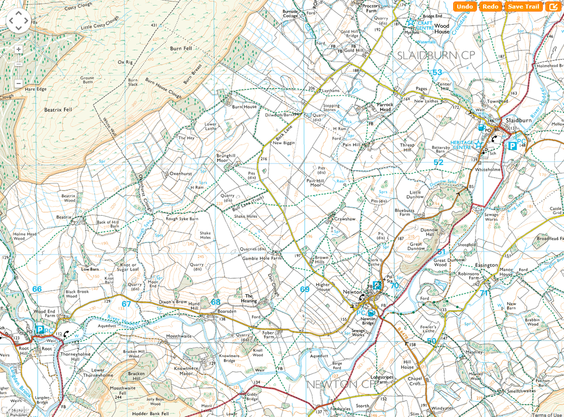
SHEET 13
CP8

Slide 2
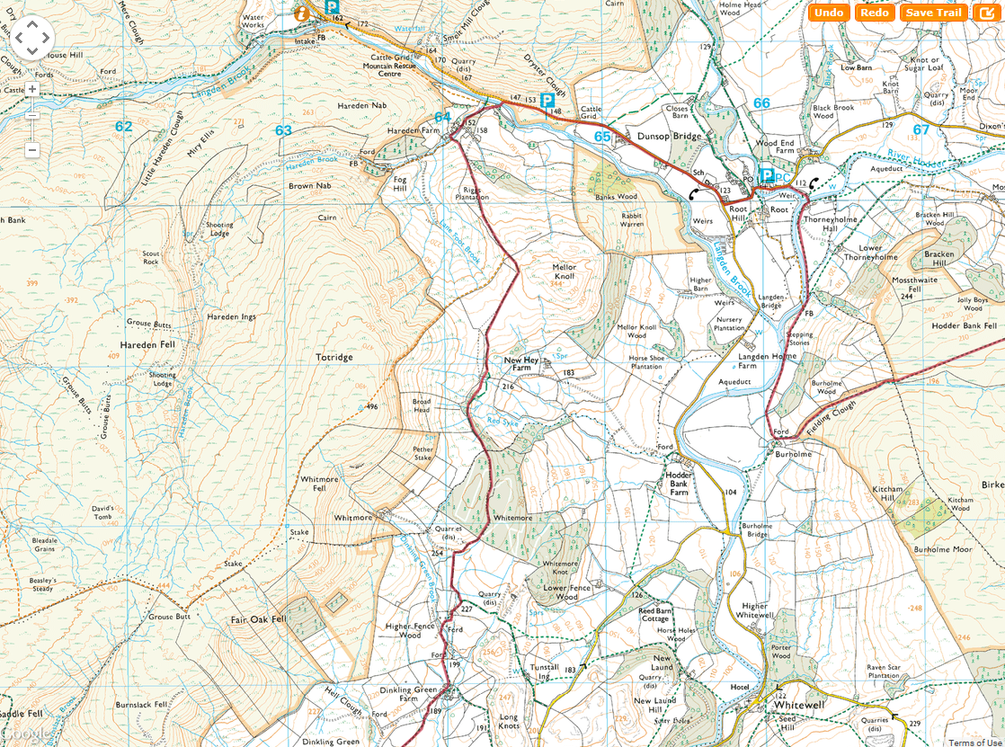
SHEET 14
CP9

Slide 3
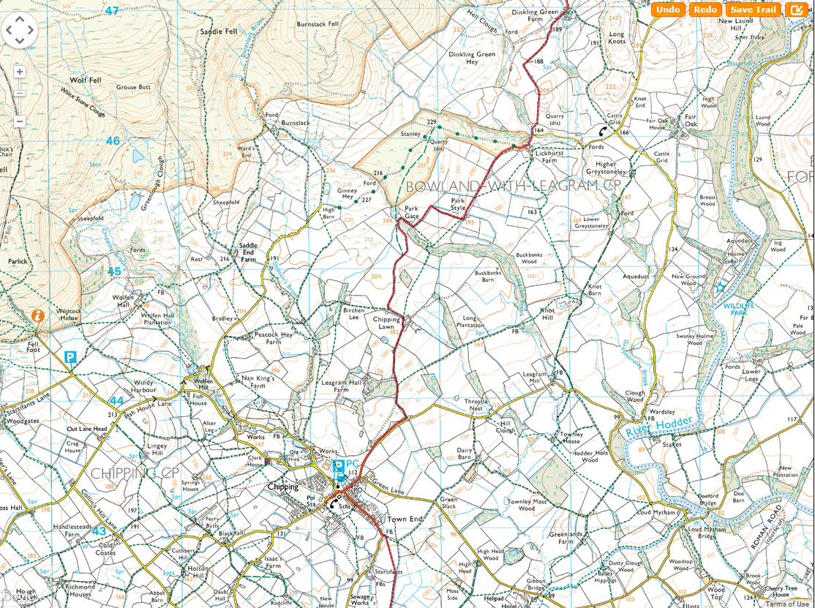
SHEET 15
CP10

Slide 4
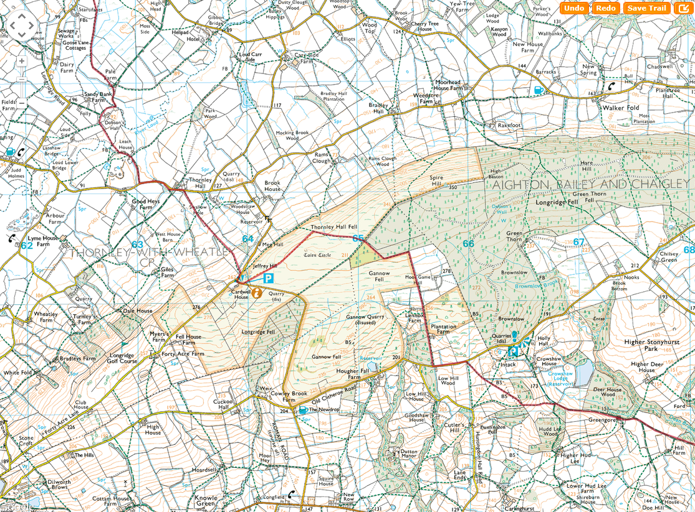
SHEET 16

