Slide 1
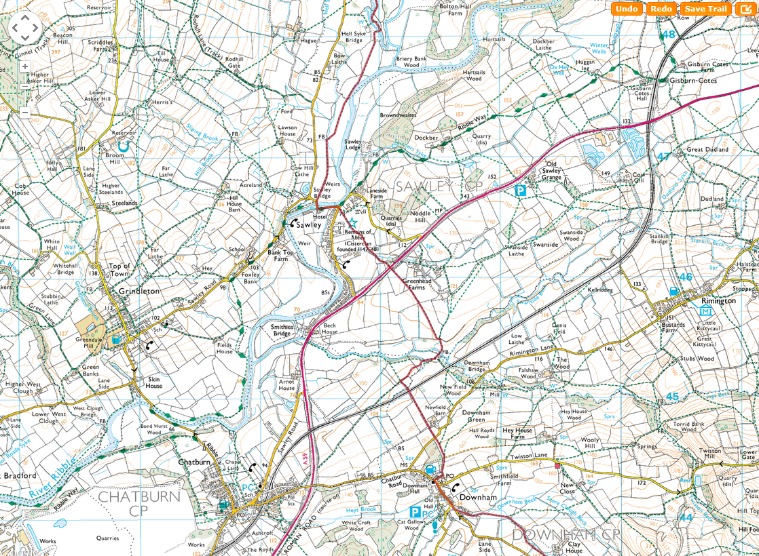
SHEET 9
CP5

Slide 2
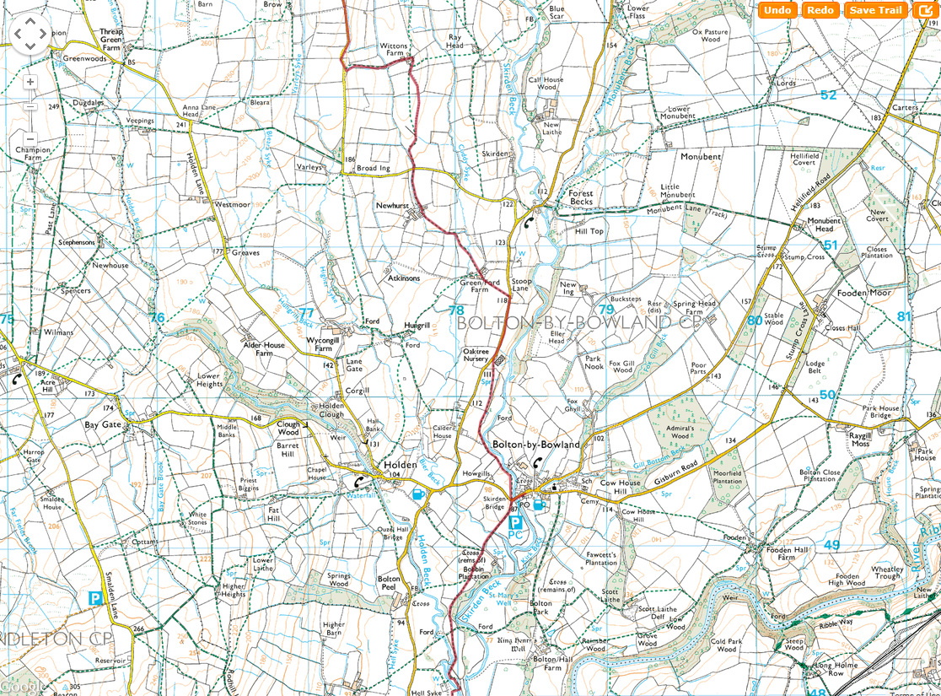
SHEET 10
CP6

Slide 3
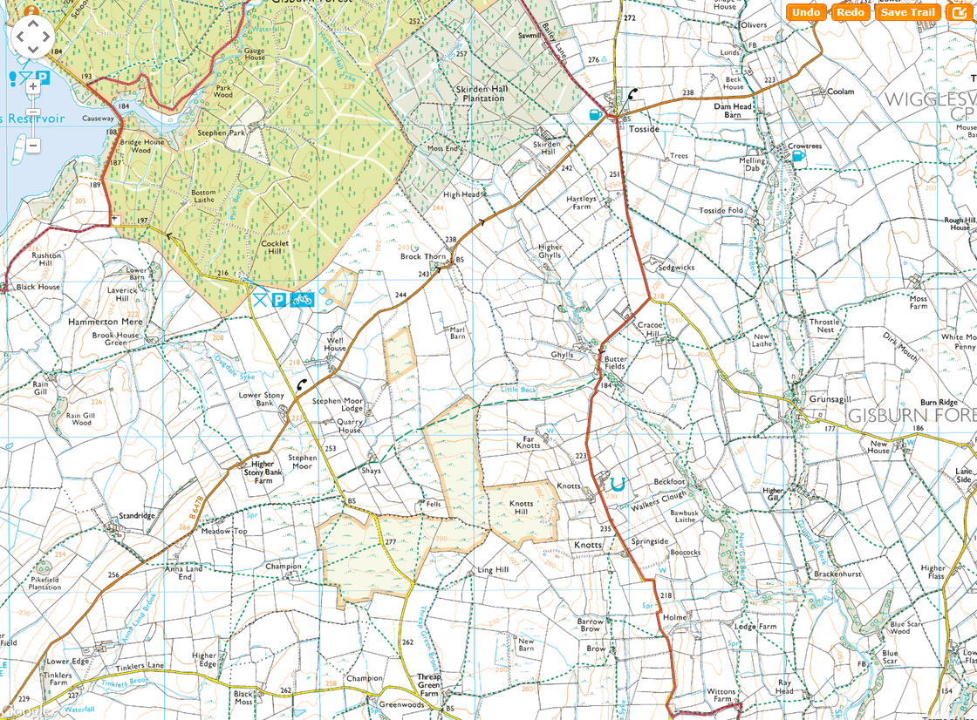
SHEET 11
CP7

Slide 4
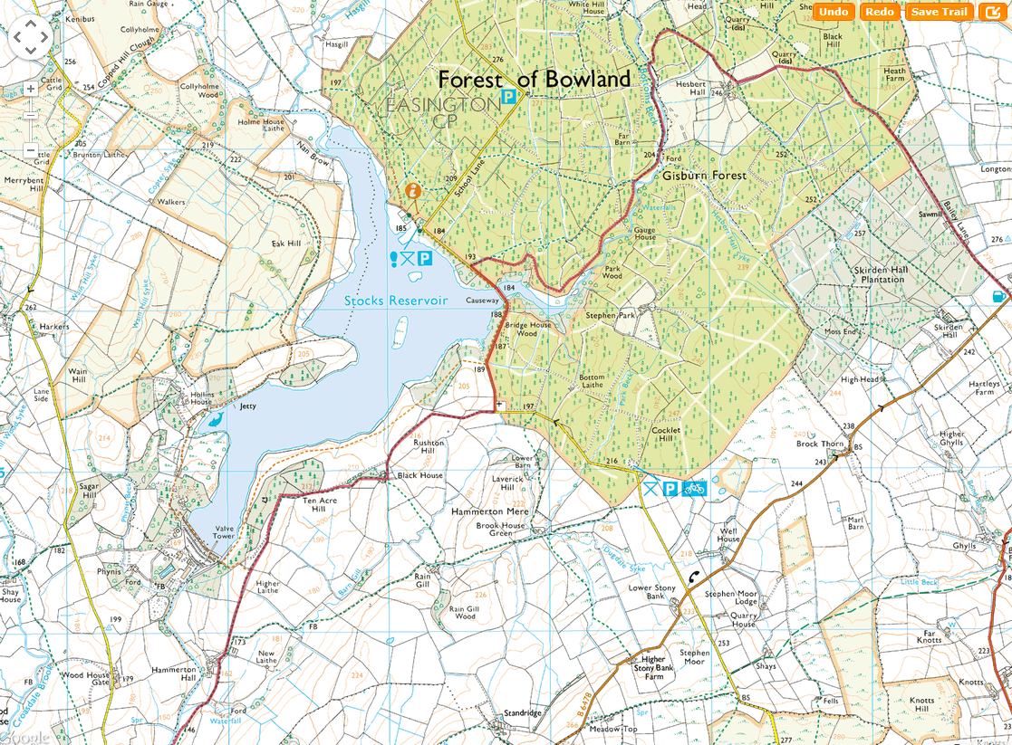
SHEET 12

