Slide 1
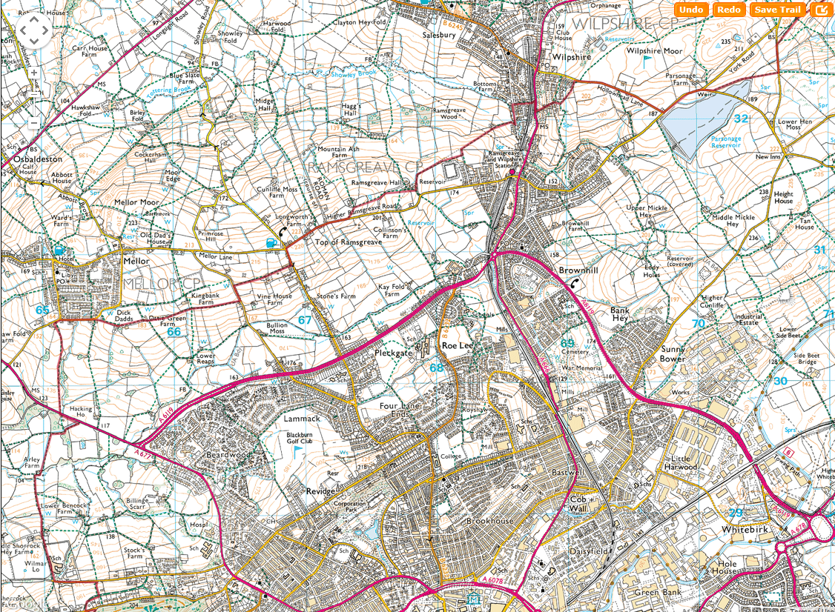
SHEET 5

Slide 2
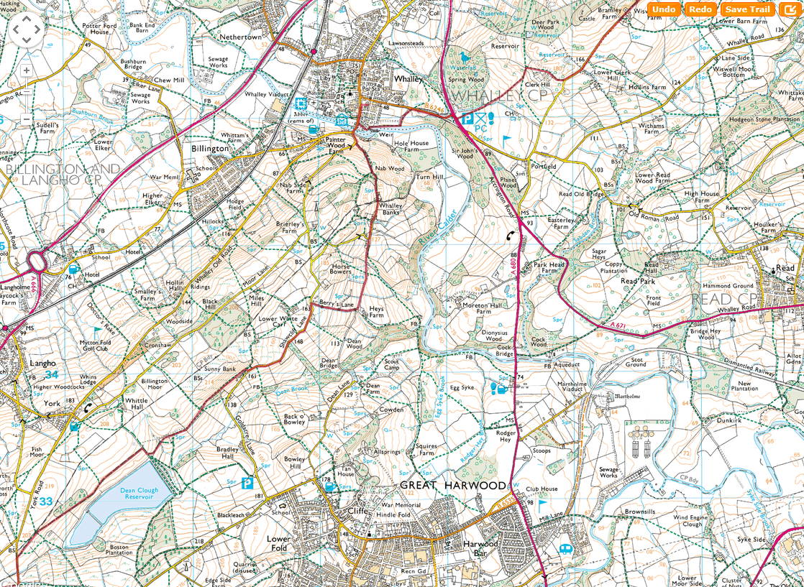
SHEET 6
CP3

Slide 3
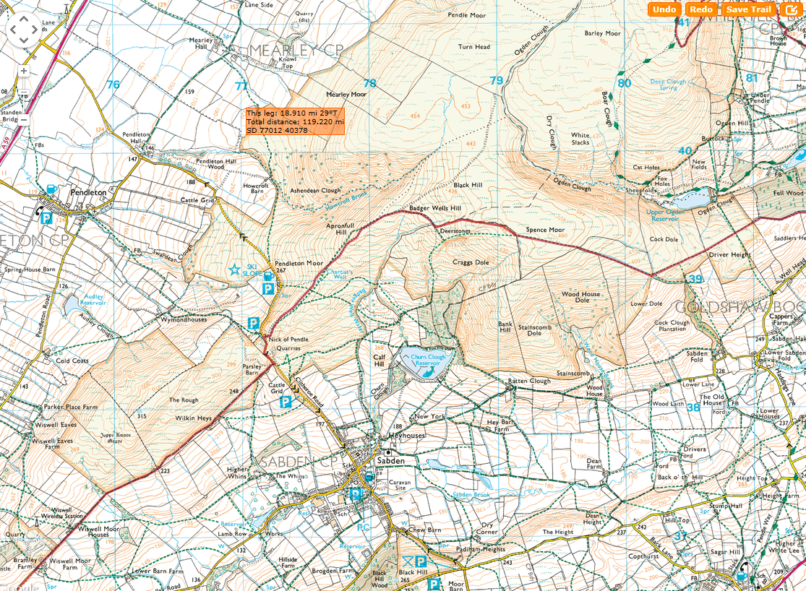
SHEET 7

Slide 4
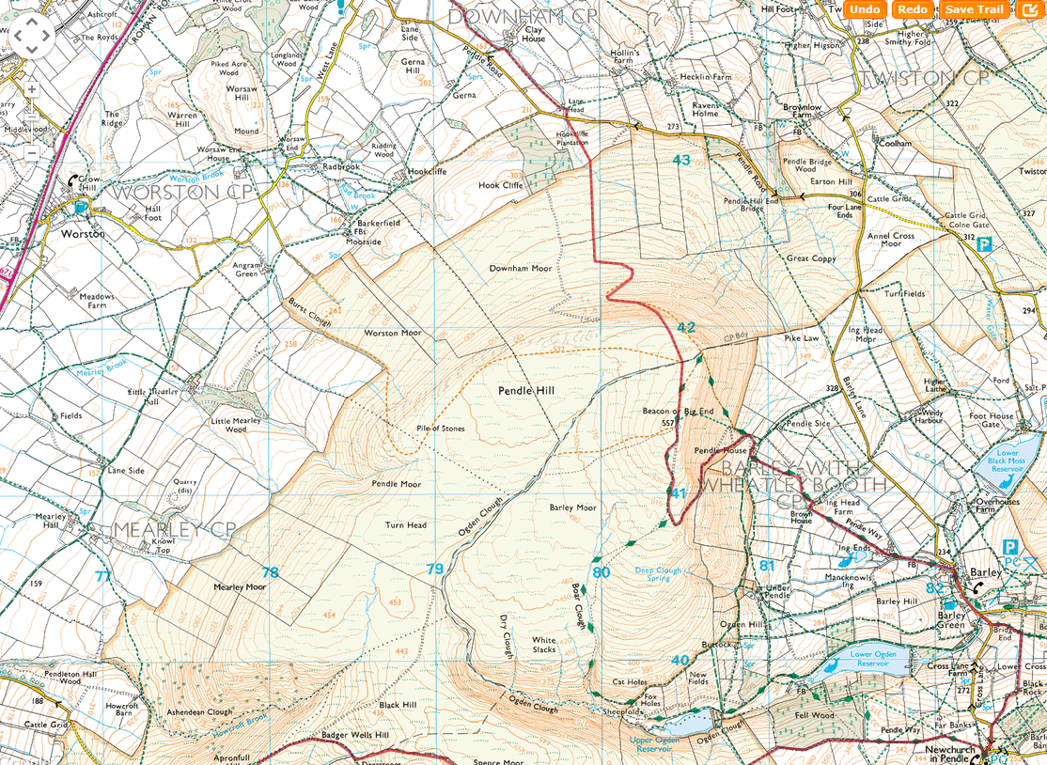
SHEET 8
CP4

