Slide 1
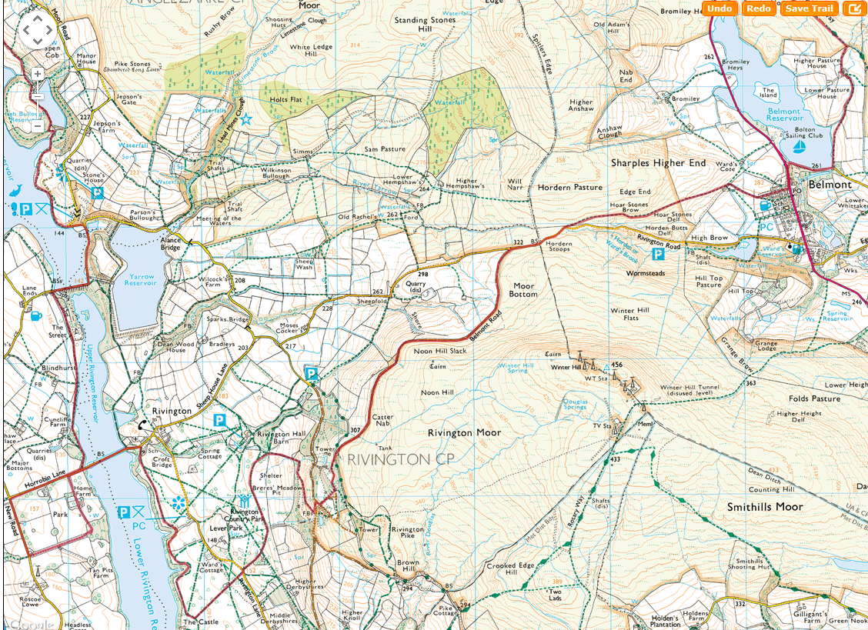
SHEET 1
START

Slide 2
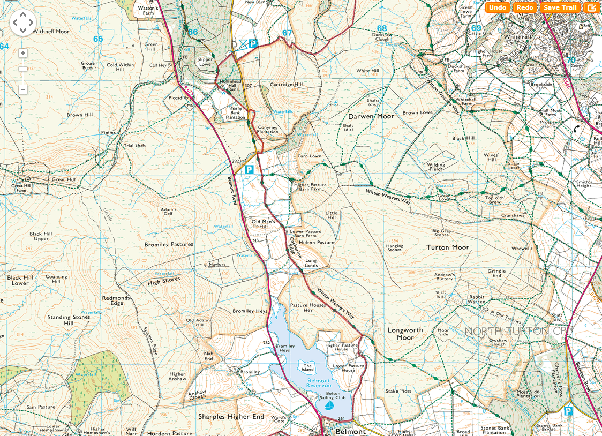
SHEET 2
CP1

Slide 3
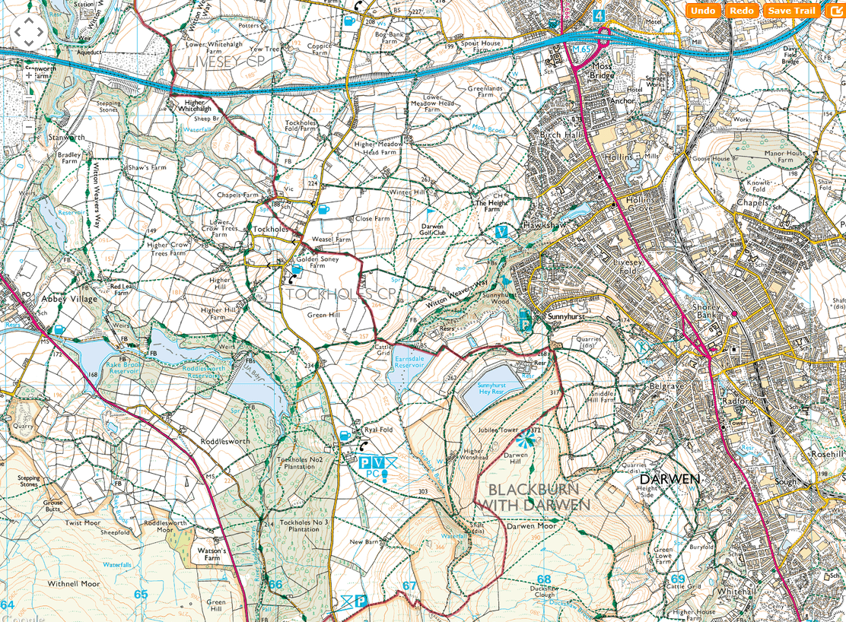
SHEET 3

Slide 4
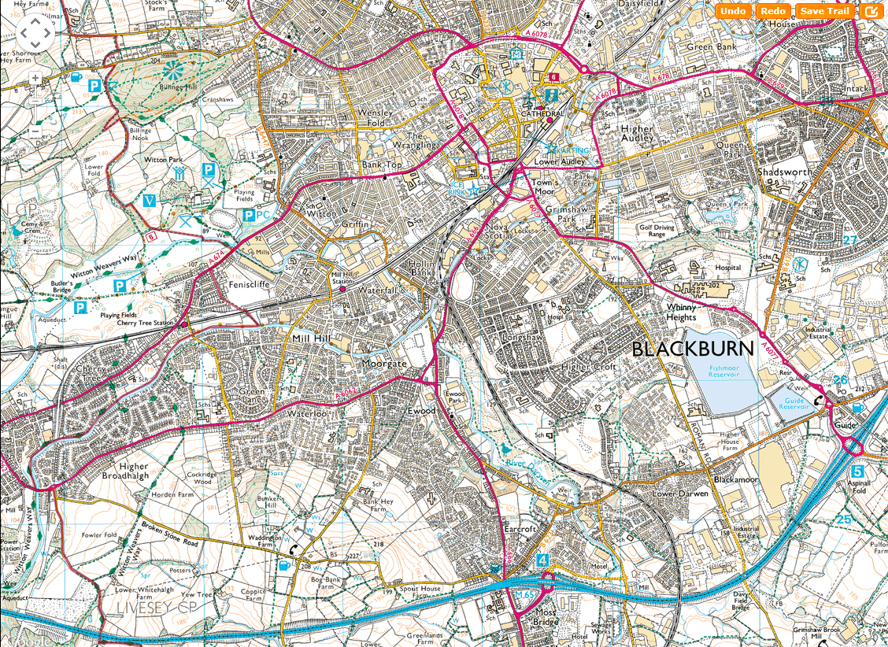
SHEET 4
CP2

